Slide 1

There is no place like ComfortHome

Slide 2
Problem
Today smart home solutions are data-focused and not focused on the humans living in it.
How do we make homes more comfortable while making a difference for the planet?
Why is this important?
To create a comfortable user-centric environment at home
More time spent at home during the covid year
Your home can help you ease your mind and promote calm and balance to your daily life
Notes:
Define the pain that you are looking to alleviate

Slide 3
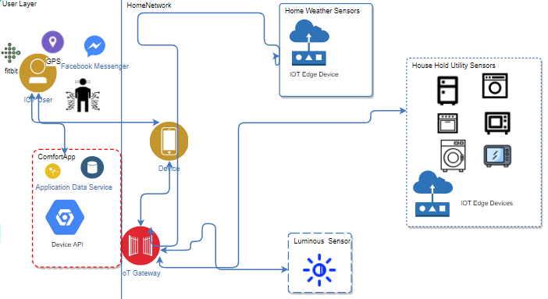
Solution
ComfortHome : Incentivizing sustainability by making smart homes user-centric
ComfortHome App helps the user ease their mind and promote calm and balance in their daily life.
Responsive smart-home technology that redefines comfort based on user data
User-centric rather than technology centric
How does it work?
Biometric data
Heart rate
Skin temperature
Electro-dermal activity (EDA)
Would require fit bit type device
Responsive settings
Learns user preferences
Notes:
Show how your solution addresses the pain

Slide 4
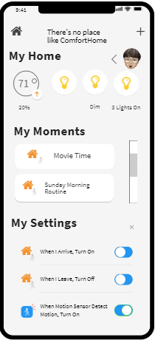
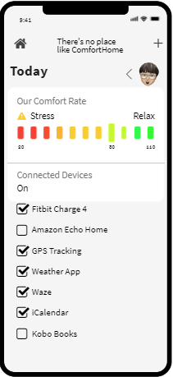
X-Factor
COMFORT
Physical
Mental
Data Privacy
Economic
Notes:
Highlight the secret sauce that your solution employs

Slide 5
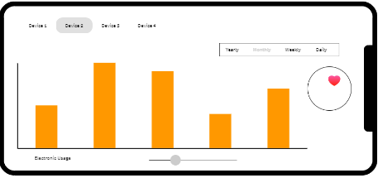
Impact
Increase user quality of life
$$$ Utility Bill
Reduction in Co2 consumption
Business Model:
Multi-tier paid subscription
Free 10 Day Trial
Basic
Premium
Notes:
Show the scope of the impact that your solution can have, and how will intend on preserving your users’ privacy and data rights

Slide 6
Team
Jessica Forrest-Baldini - Data Scientist, USA
Nicola Lombardi - Data Scientist, Spain
Katerina Maxouri - Data Scientist, Greece
Sarath P - Data Scientist, USA
Notes:
Who is involved in the project and what are their roles

Slide 7
Links
GitHub Repo w/Links
Notes:
Show how your solution addresses the pain

